Slide 1
🚖
Indian Cabs
Cab Booking System — Project Presentation
Full-stack web-based cab booking platform
React 19 + Vite • Node.js + Express • MongoDB + Mongoose
Customer • Driver • Admin
Created by Chaurasiya Nilesh

Slide 2
Presentation Overview
• Project Introduction
• Existing System & Problem Statement
• Objectives and Scope
• Technology Stack
• System Architecture & Data Flow
• Database Design
• Backend APIs
• Frontend Application
• Business Logic
• Authentication & Security
• Testing, Deployment and Error Handling
• Advantages, Limitations and Future Scope
2

Slide 3
1. Introduction
• Indian Cabs is a web-based on-demand cab booking system.
• Connects passengers with drivers through a centralized platform managed by an administrator.
• Implements the complete ride lifecycle from request and matching to completion and review.
• Provides fare estimation, ride status tracking, wallet payments and commission management.
• Uses a three-tier architecture: React presentation layer, Express application layer and MongoDB data layer.
3

Slide 4
2. Key Features
Authentication
Ride Booking
Tracking
Customer, Driver and Admin role-based login.
Pickup/dropoff, vehicle selection and fare estimate.
Status updates, ETA countdown and waiting timer.
Wallet
Commission
Reviews
Recharge, ride payment and cancellation refund.
Automatic driver/admin fare split.
1–5 star rating with optional comments.
4

Slide 5
3. Existing System Limitations
• Manual or phone-based booking is time-consuming and error-prone.
• Fares may be negotiated, creating inconsistency and disputes.
• Customers have no clear real-time driver or ride status.
• Cash-based payment makes accounting, refunds and reconciliation difficult.
• No centralized administration for drivers, rides and platform analytics.
• No structured rating/feedback mechanism and limited scalability.
5

Slide 6
4. Problem Statement
Customer Problems
Driver Problems
Admin Problems
• Uncertain driver availability
• No upfront fare transparency
• Long/uncertain waiting
• Limited payment options
• No structured feedback
• Difficulty receiving nearby requests
• No unified ride lifecycle
• Manual earning tracking
• Limited vehicle management
• No centralized monitoring
• Manual driver management
• Difficult revenue tracking
• Limited analytics
6

Slide 7
5. Objectives
• Develop an online cab booking platform with fare estimation and ride tracking.
• Implement role-based access for Customer, Driver and Admin.
• Automate transparent distance-based fare calculation.
• Manage the full ride lifecycle with real-time status updates.
• Provide a digital wallet with recharge, payment and refund capabilities.
• Match customers with nearby available drivers using the Haversine formula.
• Provide administration, ratings, multiple vehicles and scalable modular design.
7

Slide 8
6. Scope of the System
In Scope
Future / Out of Scope
• Registration & JWT authentication
• Ride booking and distance calculation
• Driver registration and vehicle CRUD
• Ride lifecycle management
• Wallet and payment processing
• Commission and refunds
• Admin dashboard and monitoring
• Rating system and theme support
• MongoDB data storage
• GPS map visualization
• Push notifications
• Real payment gateway
• OTP authentication
• Multi-city operations
• Advanced scheduling
• Native mobile apps
• In-app chat
• Surge pricing
• Driver KYC/document verification
8

Slide 9
7. Technology Stack
Frontend
Backend
Database
Alternative
React 19
Vite 8
TypeScript 6
React Router DOM 7
TailwindCSS 4
Node.js 18+
Express.js 4.19.x
JWT
bcryptjs
CORS + dotenv
MongoDB 6+
Mongoose 8.2.x
Document-oriented NoSQL
PHP 8.2+
Laravel 11.x
MySQL 8.0+
Sanctum + Eloquent
9

Slide 10
8. Three-Tier System Architecture
React 19 + Vite
Presentation Layer
Node.js + Express
Application Layer
MongoDB + Mongoose
Data Layer
• Client browser provides role-specific dashboards.
• REST API handles authentication, business logic and ride orchestration.
• MongoDB stores users, rides, payments, reviews and wallets.
10

Slide 11
9. System Architecture Components
Frontend
API Layer
Models
Database
Login / Register
Customer Dashboard
Driver Dashboard
Admin Dashboard
CORS
JSON parser
JWT middleware
Controllers
User
Ride
DriverDetail
Payment
Review
Wallet
Users
Rides
Payments
Reviews
Wallets
Transactions
11

Slide 12
10. Data Flow Diagram
Customer
Express API
MongoDB
Driver
Express API
MongoDB
Admin
Express API
MongoDB
12

Slide 13
11. Module Interaction
Frontend Modules
Backend Modules
Data Modules
Login / Register
Customer Dashboard
Driver Dashboard
Admin Dashboard
Theme Toggle
API Service Layer
Auth Controller
Customer Ride Controller
Driver Controller
Admin Controller
Wallet Controller
Auth Middleware
Users
Rides
Driver Details
Payments
Reviews
Wallets
Wallet Transactions
13

Slide 14
12. Project Structure
cab-booking/
├── cab-backend-node/
│ ├── controllers/
│ ├── middleware/
│ ├── models/
│ ├── server.js
│ ├── seed.js
│ └── package.json
├── cab-frontend/
│ ├── src/components/
│ ├── src/services/api.ts
│ ├── App.tsx
│ └── main.tsx
├── start.sh
├── stop.sh
├── status.sh
└── test.sh
14

Slide 15
13. Database Design
• Database: cab_booking
• Database technology: MongoDB NoSQL with Mongoose ODM.
• Seven primary collections support the application.
• ObjectId references connect users, rides, payments and related records.
• Flexible document storage suits the JavaScript/Node.js stack.
• Mongoose provides validation, virtual relationships and middleware hooks.
15

Slide 16
14. Database Collections
users
rides
driverdetails
payments
Accounts: customer, driver, admin
Booking, locations, status, fare
Vehicle and driver location
Amount, commission, earning
reviews
wallets
wallettransactions
Rating and comment
Current wallet balance
Deposit, payment, refund logs
16

Slide 17
15. ER Diagram — Main Relationships
USER
DRIVER_DETAIL
RIDE
WALLET
REVIEW
PAYMENT
WALLET_TX
17

Slide 18
16. Backend API — Authentication
Register
Login
Session APIs
POST /api/register
Creates a new Customer or Driver account.
Driver registration may include vehicle details.
Returns user + JWT token.
POST /api/login
Validates email/password.
Returns JWT on success.
Suspended accounts receive 403.
POST /api/logout
GET /api/me
JWT is stateless; client removes stored token on logout.
18

Slide 19
17. Customer Module
• Find nearby available drivers using latitude, longitude and a search radius.
• Book a ride using pickup/dropoff, distance, vehicle type and payment method.
• View paginated ride history and complete ride details.
• Cancel eligible rides; wallet-paid rides receive automatic refunds.
• Rate completed rides from 1–5 stars with an optional comment.
• View and recharge wallet; maximum wallet balance is ₹2,000.
19

Slide 20
18. Driver Module
• Go online/offline and periodically update location availability.
• Receive nearby requests matching the driver's vehicle type.
• Accept a ride using an atomic update to avoid duplicate acceptance.
• Estimated pickup time is set to a random 1–3 minute ETA.
• Progress ride: Arrived at Pickup → Start Ride → Complete Ride.
• Manage vehicle details and view ride history, earnings and rating.
20

Slide 21
19. Admin Module
• Dashboard statistics: total earnings, completed rides, users and active drivers.
• View/search/filter users by role and status.
• Suspend or activate users; self-account status cannot be modified.
• Delete drivers when constraints are satisfied.
• Monitor active bookings and browse paginated ride history.
• Add drivers directly with account and vehicle details.
• Dashboard data auto-refreshes every 2 seconds.
21

Slide 22
20. Frontend Application
Routing
Customer UI
Driver/Admin UI
/login → Login
/register → Register
/customer → Customer
/driver → Driver
/admin → Admin
* → Login
Booking panel
Live fare preview
Active ride tracking
Ride history
Wallet
Rating modal
Profile modal
Driver online toggle
Requests + countdown
Trip status controls
Earnings & rating
Admin statistics
Driver roster
Active bookings
22

Slide 23
21. Fare Calculation
Formula
Car
Fare = Distance (km) × Rate per km
₹30 / km
Bike
₹10 / km
• Duration estimate = ceil((distance / 30 km/h) × 60).
• Client-side fare estimation matches backend logic.
• Fare returns 0 when pickup/dropoff is empty or distance is invalid.
Rickshaw
₹20 / km
23

Slide 24
22. Ride Lifecycle
Requested
Accepted
Waiting for
Customer
In Progress
Completed
• Customer can cancel before completion in eligible states.
• Driver completion triggers payment processing, wallet credits and transaction logs.
24

Slide 25
23. Payment, Commission & Wallet
Payment
Commission
Wallet
Payment record starts as pending.
Wallet payment is deducted at booking.
Completion marks payment completed.
Cancellation can trigger a full wallet refund.
admin_commission = fare × 10%
driver_earning = fare − commission
Driver and admin wallets are credited on completion.
Deposit = recharge/earning
Payment = ride deduction
Refund = cancellation refund
Transactions provide an audit trail.
25

Slide 26
24. Driver Matching — Haversine Formula
Matching Rules
Process
• Driver must be available.
• Vehicle type must match.
• Pickup must be within 15 km.
• Results are sorted nearest first.
1. Customer supplies pickup/dropoff coordinates.
2. API calculates distance using Haversine formula.
3. Backend queries online drivers.
4. Drivers are filtered by vehicle type and 15 km radius.
5. Nearest matching driver is prioritized.
6. Ride request is saved and driver is alerted.
26

Slide 27
25. Authentication & Security
User Login
API Validation
JWT Generated
Role Dashboard
• Passwords are hashed using bcrypt with 10 salt rounds.
• JWT tokens expire after 30 days and are verified on protected requests.
• Role-restricted middleware prevents unauthorized feature access.
• Suspended users receive 403 responses.
• Atomic ride acceptance helps prevent race conditions.
• Payout flag prevents duplicate earnings distribution.
27

Slide 28
26. Software Testing
Unit
Integration
System
UAT
Deployment
Unit Testing
Integration Testing
UAT Result
Haversine distance
Fare calculation
Password hashing/comparison
Pagination
Vehicle type mapping
Authentication APIs
Customer ride APIs
Driver APIs
Wallet APIs
Database operations
Customer flow tested
Driver flow tested
Admin flow tested
30 total cases
30 passed • 0 failed
100% pass rate
28

Slide 29
27. Deployment, Error Handling & Future Scope
Deployment
Error Handling
Future Scope
./start.sh
./stop.sh
./status.sh
Startup script manages frontend/backend processes and can auto-start MongoDB via Homebrew.
200 Success
201 Created
401 Unauthenticated
403 Unauthorized
404 Not Found
422 Validation
500 Server Error
Frontend shows validation/network errors and loading states.
GPS map tracking
Push notifications
Payment gateway
OTP verification
Multi-city support
Mobile apps
In-app chat
Surge pricing
Driver KYC
29

Slide 30
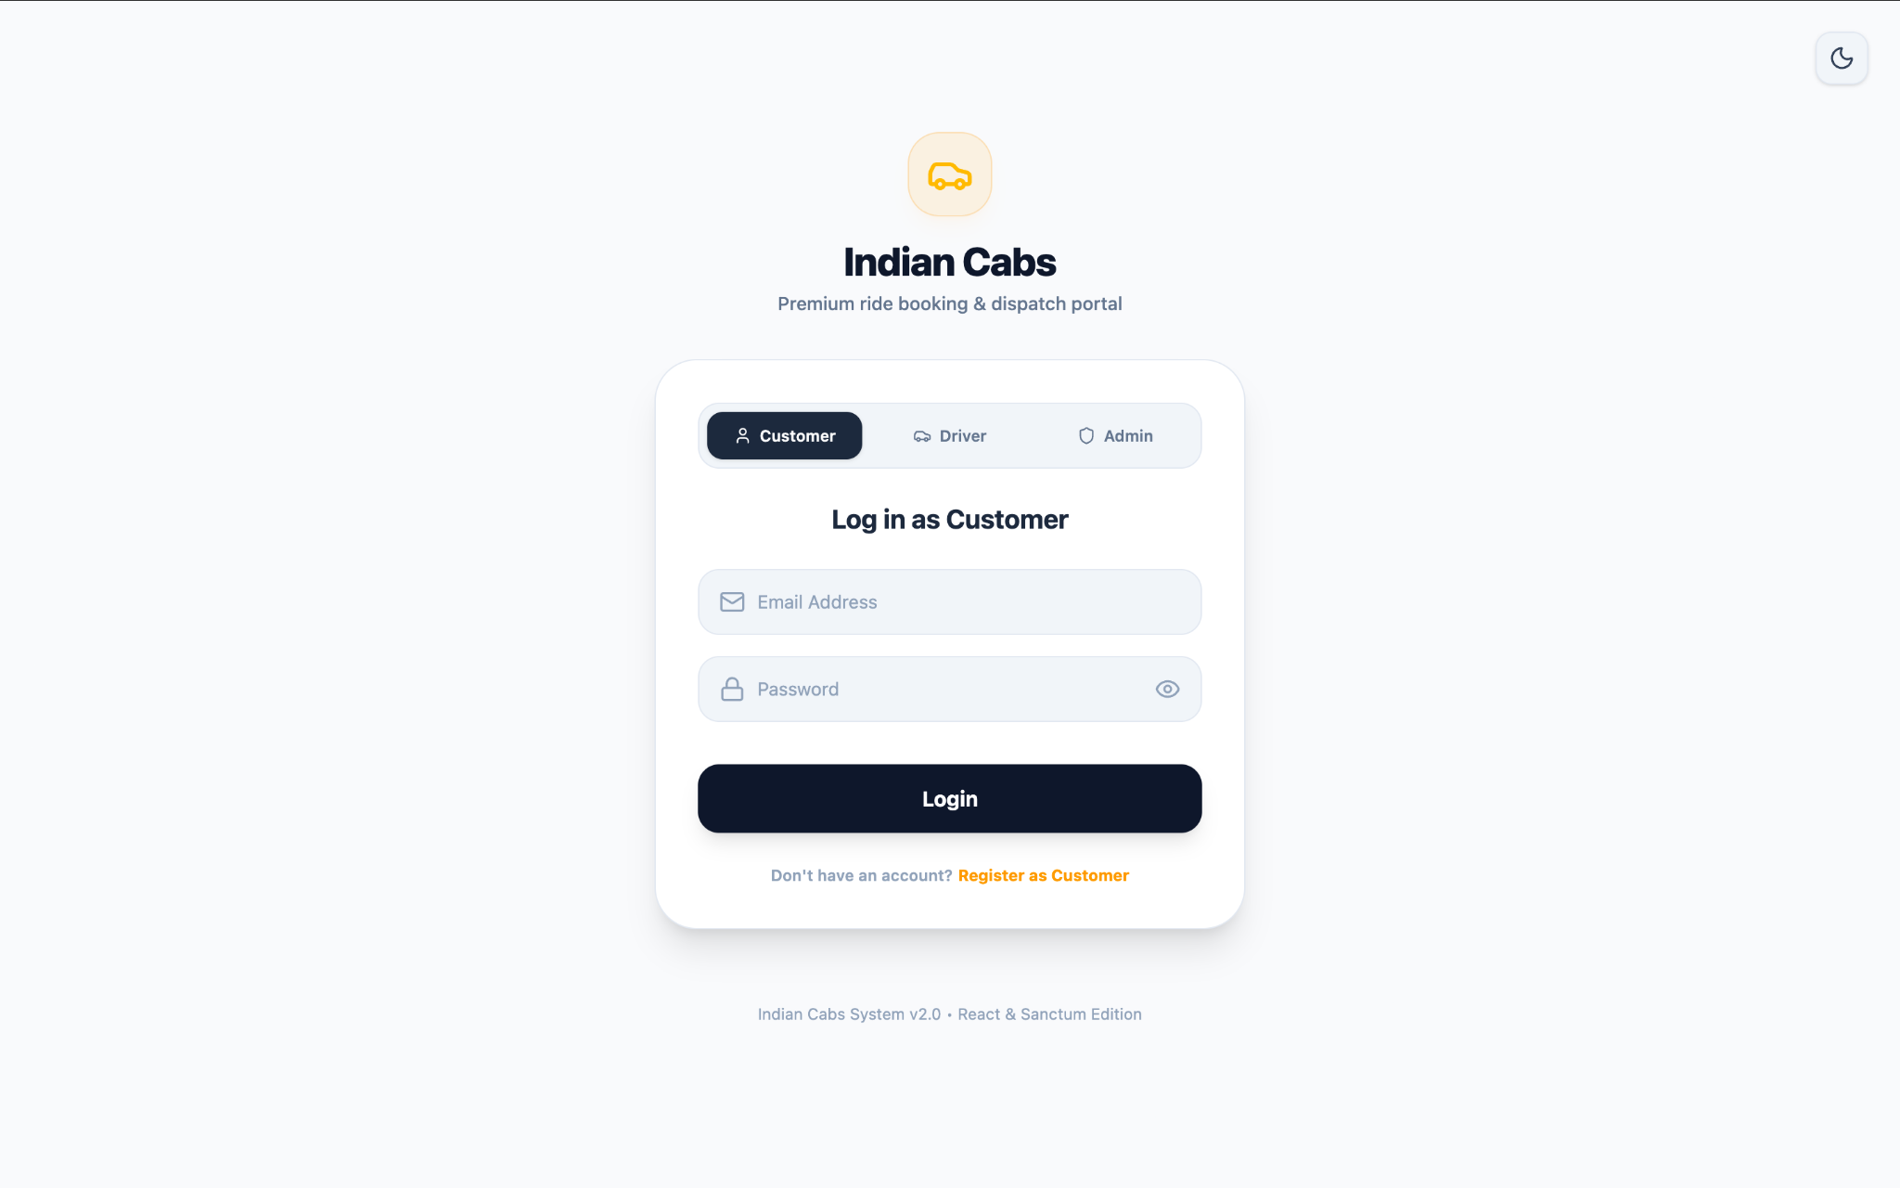
Login Page
Customer, Driver and Admin login options with a clean role-based authentication interface.
Indian Cabs — Project Interface

Slide 31
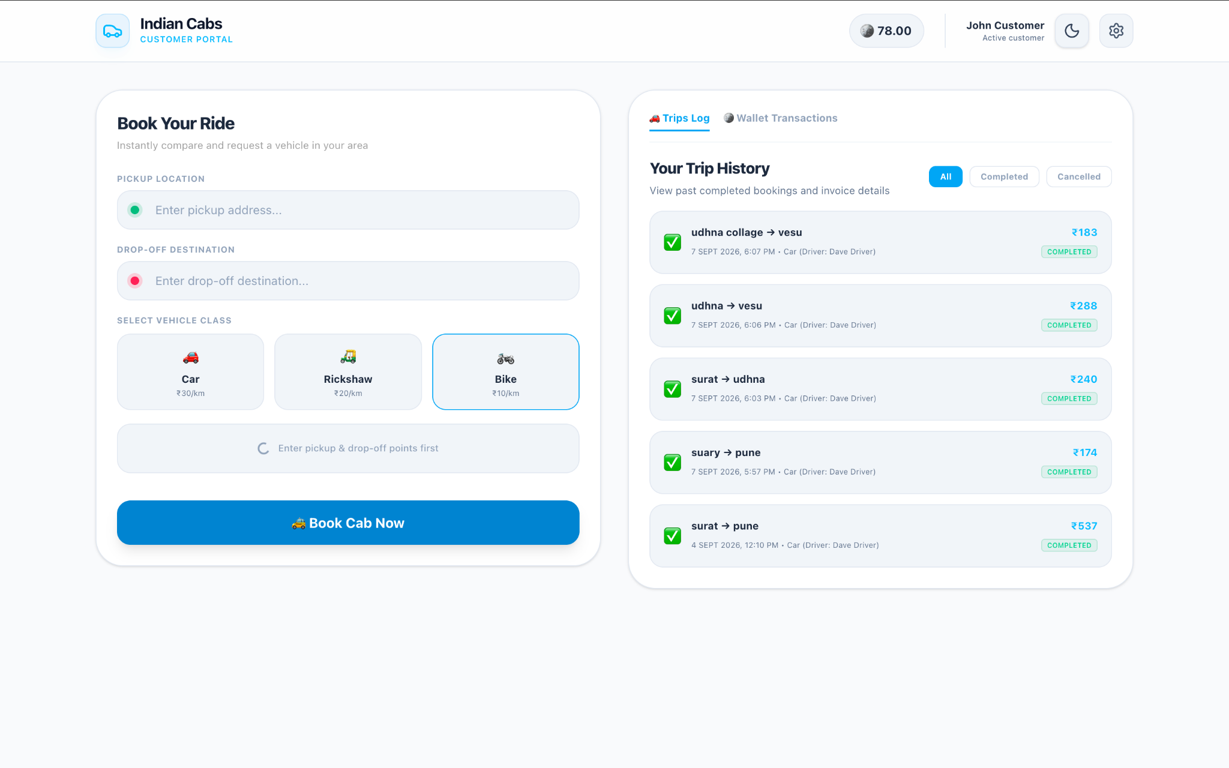
Customer Dashboard & Ride Booking
Customers can enter pickup/drop-off locations, select a vehicle class and view trip history.
Indian Cabs — Project Interface

Slide 32
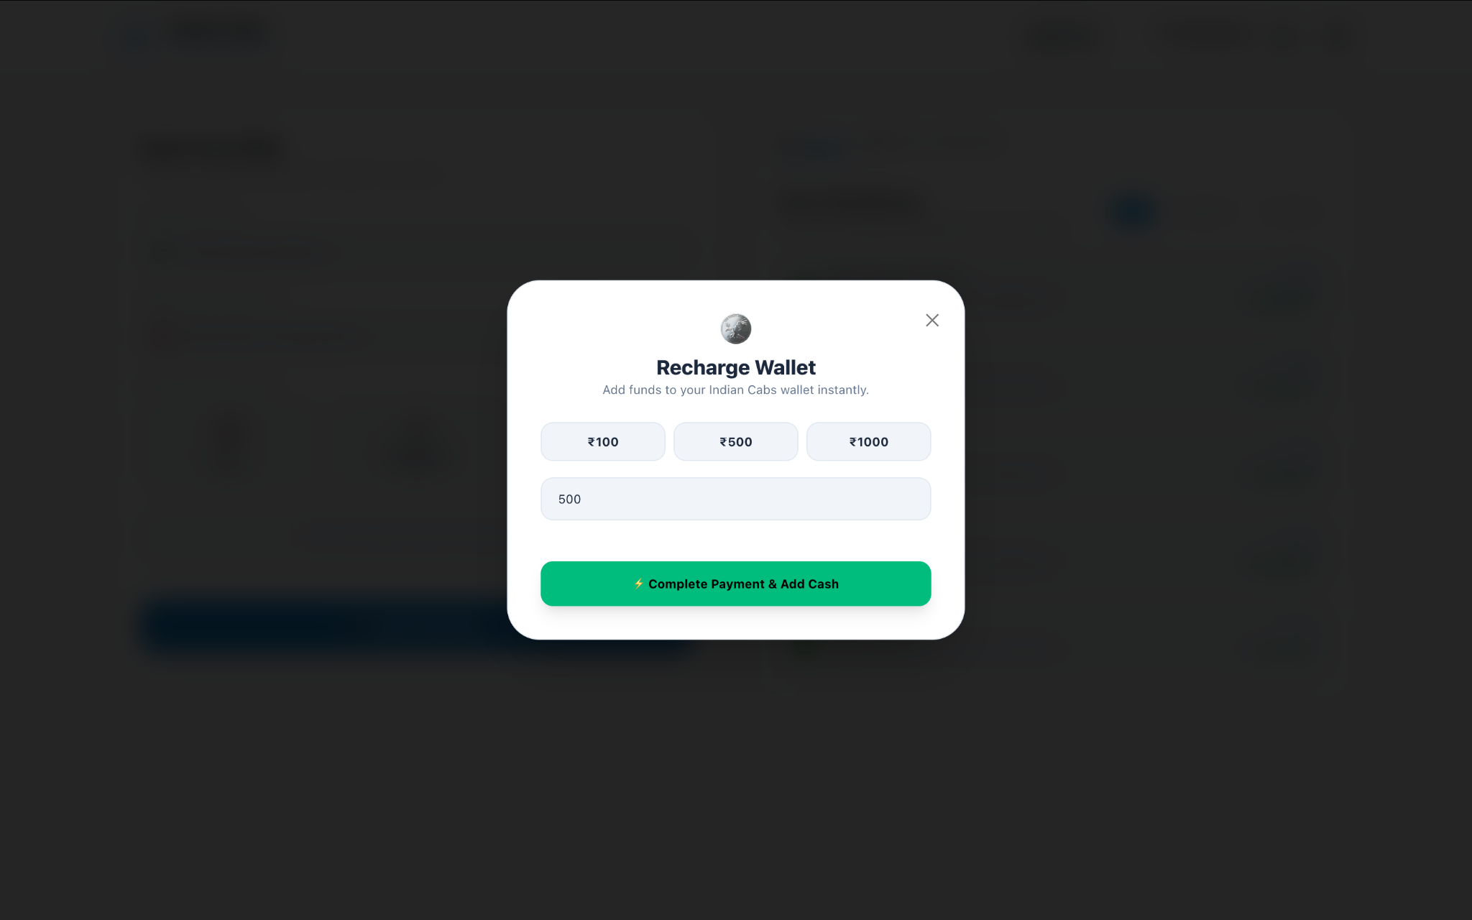
Wallet Recharge
Customers can select or enter an amount and add funds to the Indian Cabs wallet.
Indian Cabs — Project Interface

Slide 33
Project Demo
Open the Indian Cabs project in your browser
🚕 OPEN INDIAN CABS PROJECT
http://localhost:5173/login
Note: This localhost link works when the project is running on your computer.
Thank You

